Slide 1
Recyle Porject
Eco Recyleing HuB
Codelab Acadeny Team3

Slide 2
Team Member
강연배
김은지
01
02
김인수
이지우
03
04
You can describe the topic of the section here
You can describe the topic of the section here
You can describe the topic of the section here
You can describe the topic of the section here

Slide 3
Persona?
페르소나

Slide 4
10년차 주부
- 나이 40대
직업 : 전업주부
Sns활용도 : 매일
재활용 능력 : 상
특이사항 :
오랜생활 주부로 다회용기사용 및
재활용과, 분리수거를 굉장히 잘한다.
그러나 가끔 고장난 전자제품이나 큰 가구들을 버릴때마다 어떻게 버려야하는지 몰라 골머리를 썩는다.
=> 재활용센터 위치와 연락처, 취급물품등을 알기쉽게 하여 유저확보
01

Slide 5
20대 sns광
02
- 나이 20대
직업 : 대학생
Sns활용도 : 매일
재활용 능력 : 중
특이사항 :
매일 하는 sns에 어느날올라온 ‘제로웨이스트’를보고 멋있어보여
대나무칫솔, 고체치약등을 사용하려고 노력하는 중이다.
여러 제로웨이스트 샵을 한번에 볼수있으면 좋겠다라는 생각을 가지고있다.
=> 제로웨이스트샵 위치와 연락처, 취급물품등을 알기쉽게 하여 유저확보

Slide 6
30대 자취남여
03
- 나이 30대
직업 : 직장인
Sns활용도 : 하루 두세번
재활용 능력 : 중
특이사항 :
이제 막 자취를 시작해 혼자 재활용분리를 해야하는데 매번 바뀌는 정책때문에 항상 쉽지가 않다.
매일 배달음식을 먹어 일회용품이 너무많이나와 다회용기 사용을 늘리려고 하나 이것도 쉽가 않다.
=> 재활용품을 알기쉽게 올려주고,
사진을 찍어서보내면 어떤재활용인지 알려주는 챗봇을 제공, 다회용기 사용을위한 자취 꿀팁등을 제공하여 유저 확보

Slide 7
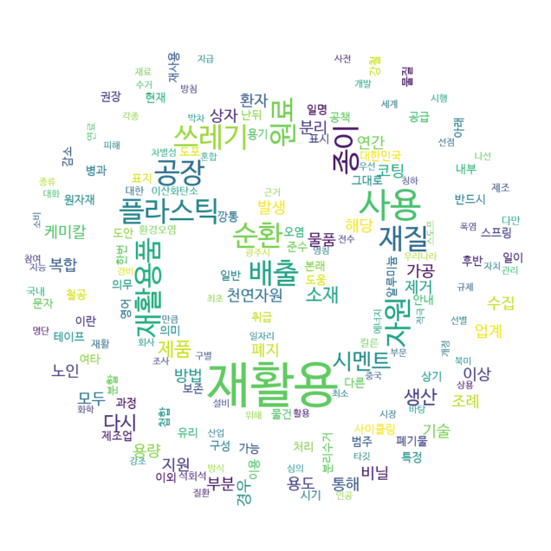
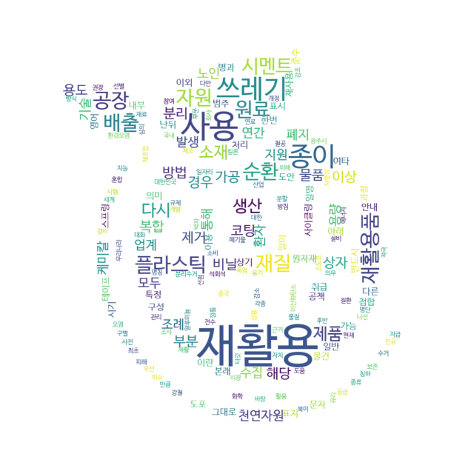
재활용

Slide 8
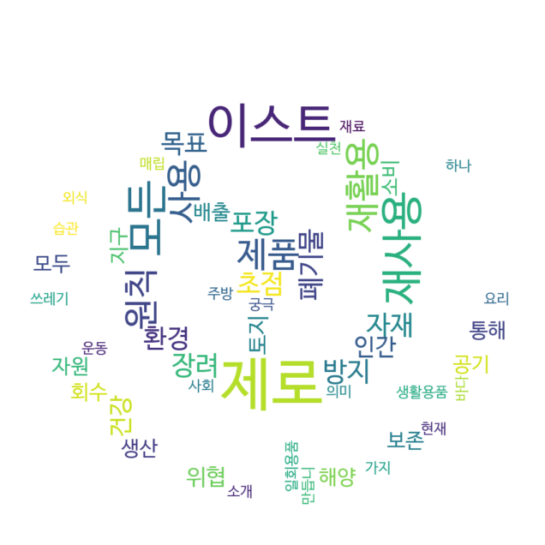
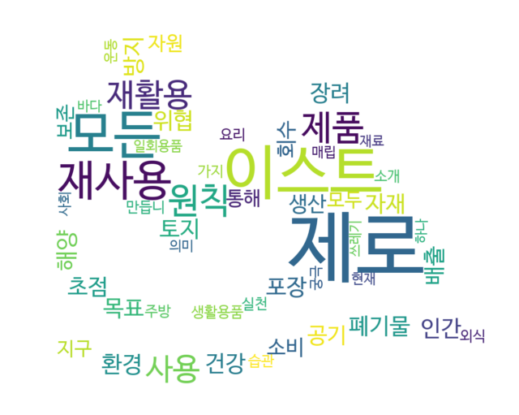
제로웨이스트

Slide 9
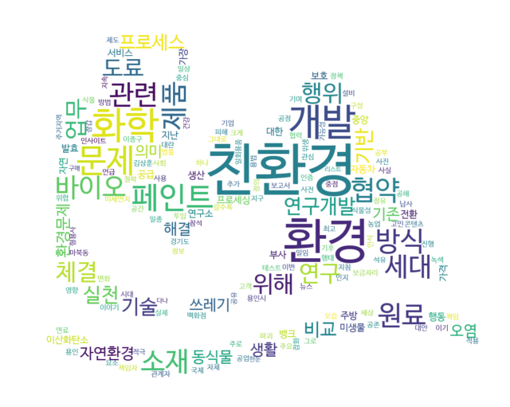
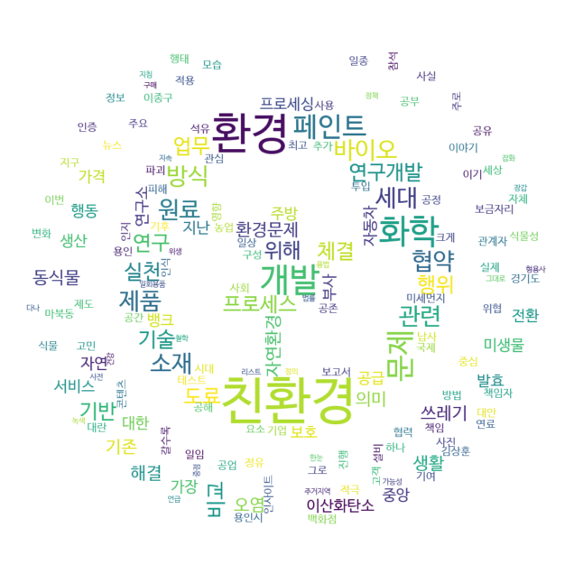
친환경

Slide 10
04
LET’S GET STARTED
You can enter a subtitle here if you need it

Slide 11
RECOMMENDATIONS
MERCURY
VENUS
MARS
JUPITER
SATURN
NEPTUNE
Mercury is the closest planet to the Sun
Venus is the second planet from the Sun
Despite being red, Mars is a cold place
It’s the biggest planet in the Solar System
Saturn is composed of hydrogen and helium
Neptune is the farthest planet from the Sun

Slide 12
MERCURY
VENUS
Development
Environment
JUPITER
NEPTUNE
SATURN
MARS
Mercury is the closest planet to the Sun
Venus is the second planet from the Sun
It’s the biggest planet in the Solar System
Neptune is the farthest planet from the Sun
It’s composed of hydrogen and helium
Despite being red, Mars is a cold place

Slide 13
REDUCTION OF PLASTIC WASTE OVER TIME
2015
2017
2020
2023
MARS
MERCURY
SATURN
VENUS
Despite being red, Mars is a very cold place
Mercury is the closest planet to the Sun
Saturn is a gas giant and has several rings
Venus is the second planet from the Sun

Slide 14
PLASTIC BOTTLE RECYCLING 101
MERCURY
STEP 1
Mercury is the closest planet to the Sun
SATURN
STEP 2
Saturn is a gas giant and has several rings
VENUS
STEP 3
Venus is the second planet from the Sun

Slide 15
EXERCISE
You can use this slide to add an exercise or an assignment for the students
Venus has a beautiful name
Venus is hotter than Mercury
Venus spins clockwise on its axis
It’s the second-brightest natural object in the night sky after the Moon

Slide 16
EXERCISE 2
BOTTLE TOP BAG SEAL
BIRD FEEDER
PLANTER
ALL ANSWERS ARE RIGHT
Here are some examples of what we can make out of a plastic bottle. Which one is right?
A
C
B
D

Slide 17
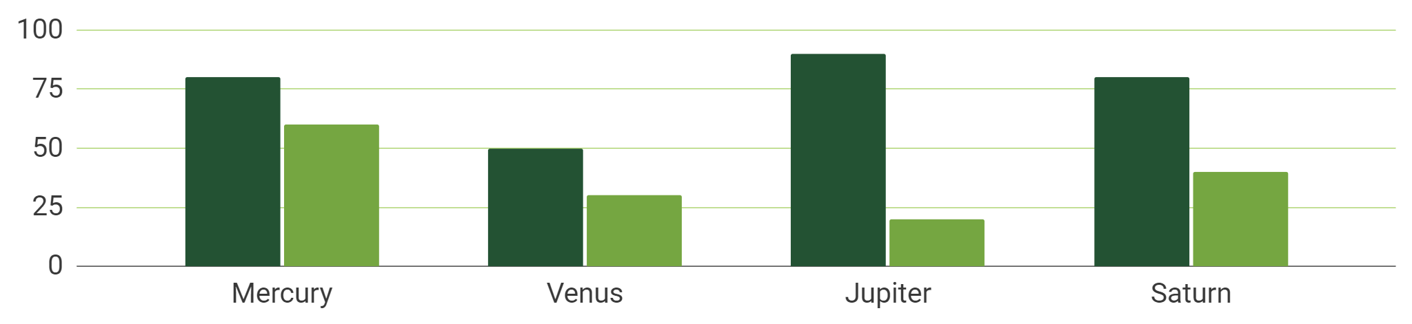
USE A GRAPH TO SHOW YOUR DATA
MERCURY
VENUS
Follow the link in the graph to modify its data and then paste the new one here. For more info, click here
Mercury is the closest planet to Sun
Venus is the second planet from the Sun

Slide 18
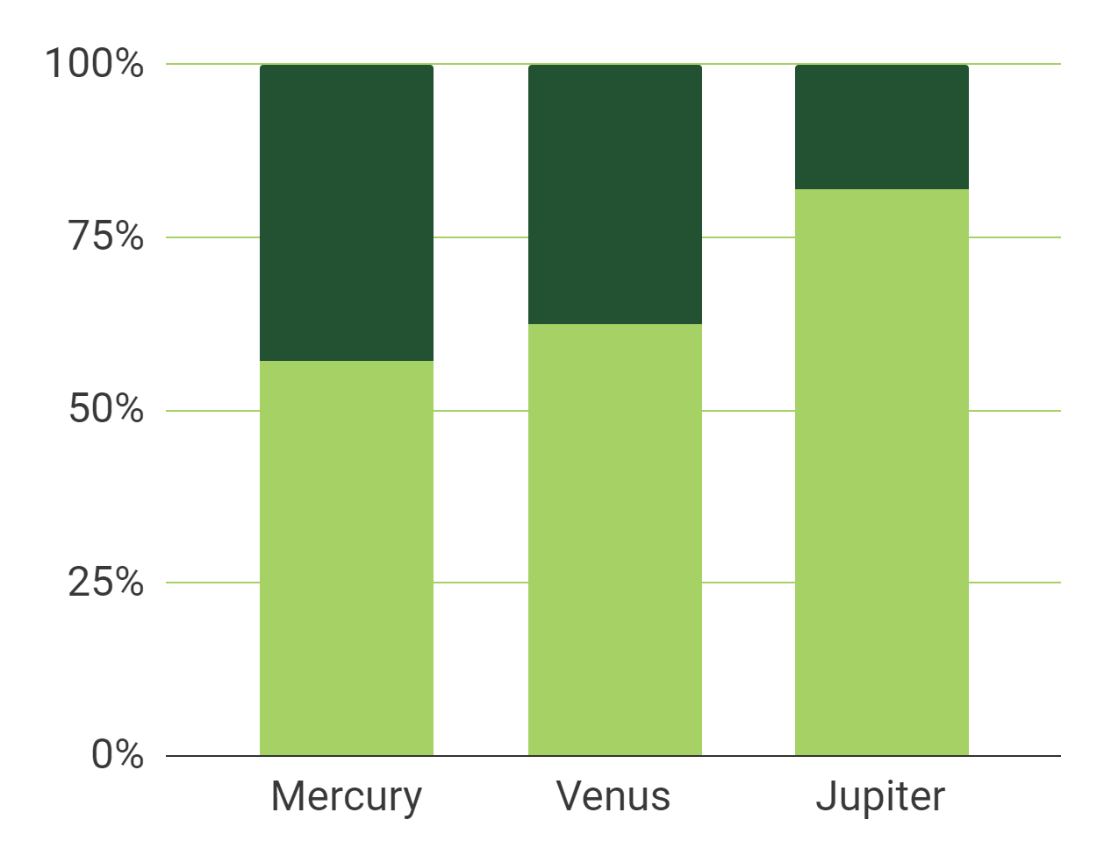
USE A GRAPH TO SHOW YOUR DATA
MERCURY
It’s the smallest planet in the Solar System
SATURN
It’s the second-largest planet in the Solar System
Follow the link in the graph to modify its data and then paste the new one here. For more info, click here

Slide 19
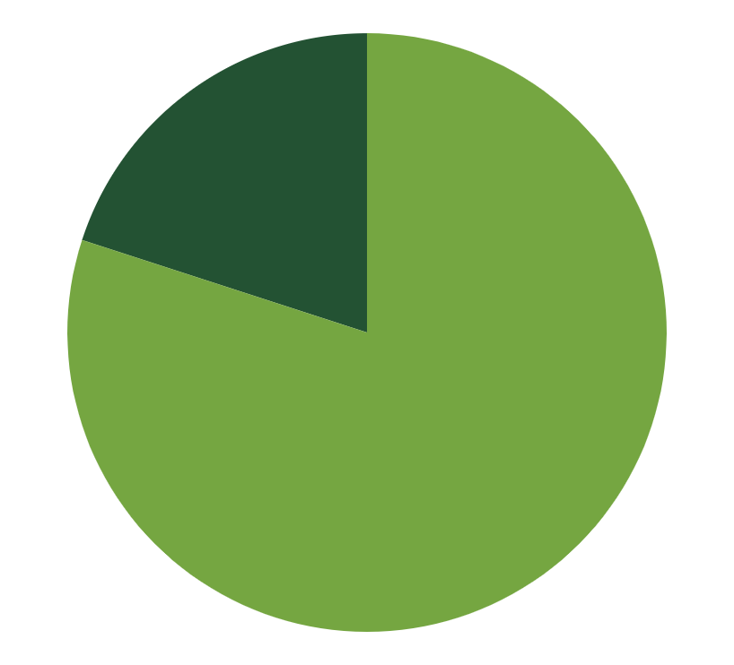
ANOTHER GRAPH
20%
80%
NEPTUNE
MERCURY
Neptune is the farthest planet from the Sun
Mercury is the closest planet to the Sun
Follow the link in the graph to modify its data and then paste the new one here. For more info, click here

Slide 20
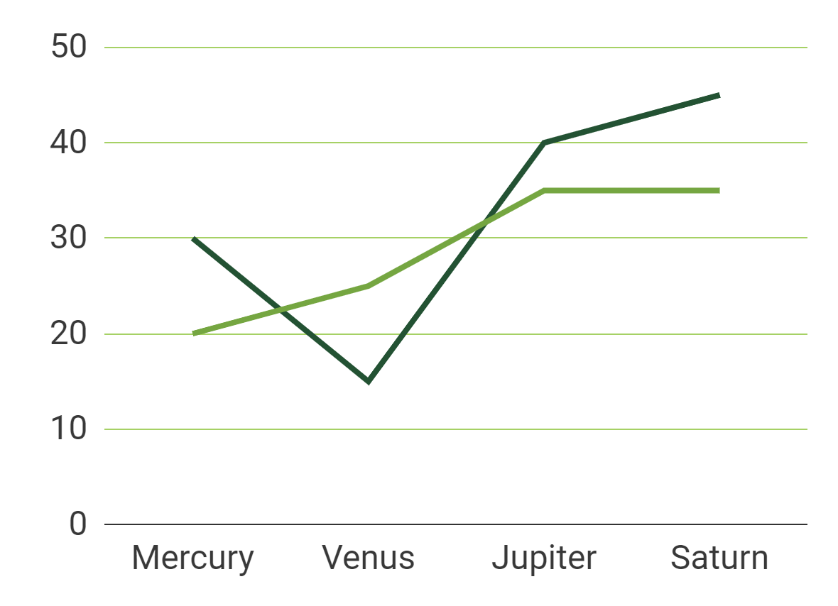
ANOTHER GRAPH
MERCURY
Mercury is the smallest planet of them all
SATURN
It’s the second-largest planet in the Solar System
Follow the link in the graph to modify its data and then paste the new one here. For more info, click here

Slide 21
SOME DATA FOR A COMPARISON
 | MASS | DIAMETER | SURFACE GRAVITY
MERCURY | 0.06 | 0.38 | 0.38
MARS | 0.11 | 0.53 | 0.38
SATURN | 95.2 | 9.4 | 1.16

Slide 22
SOME DATA FOR COMPARISON
MARS
 | MASS | DIAMETER
MERCURY | 0.06 | 0.38
MARS | 0.11 | 0.53
SATURN | 95.2 | 9.4
Despite being red, Mars is a very cold place
MERCURY
Mercury is the closest planet to the Sun
SATURN
Saturn is a gas giant and has several rings

Slide 23
RECYCLING CENTERS AROUND THE WORLD
NEPTUNE
Neptune is the farthest planet from the Sun

Slide 24
IT STARTED AS A SMALL MOVEMENT
80%
MERCURY
Mercury is the closest planet to the Sun
20%
NEPTUNE
Neptune is the farthest planet from the Sun

Slide 25
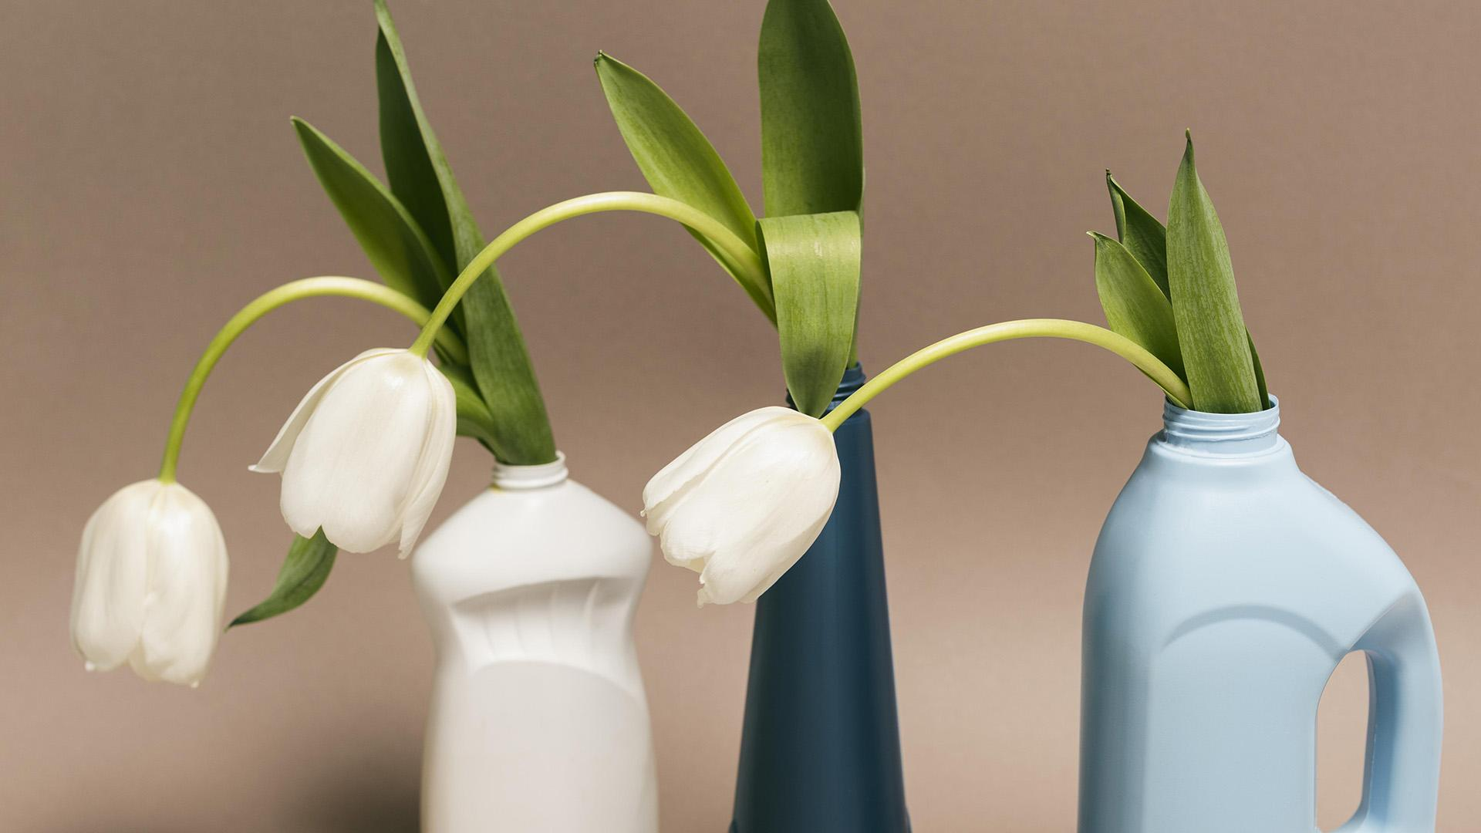
DESKTOP SOFTWARE
You can replace the image on the screen with your own work. Right-click on it and then choose "Replace image" so you can
add yours

Slide 26
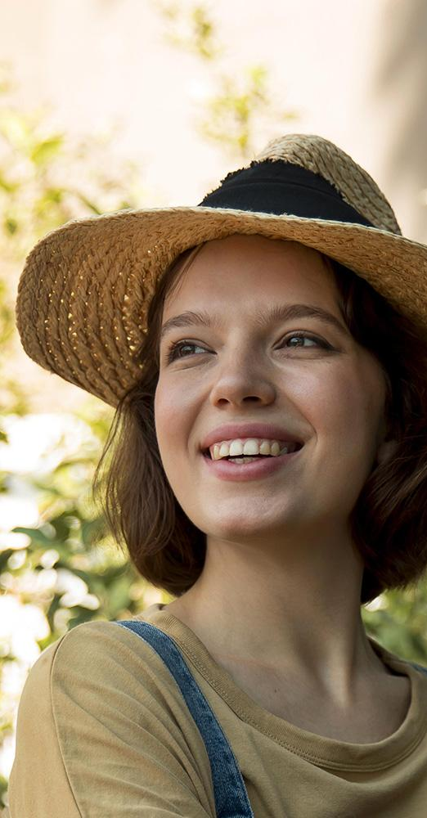
MOBILE APP
You can replace the image on the screen with your own work. Right-click on it and then choose "Replace image" so you can
add yours

Slide 27
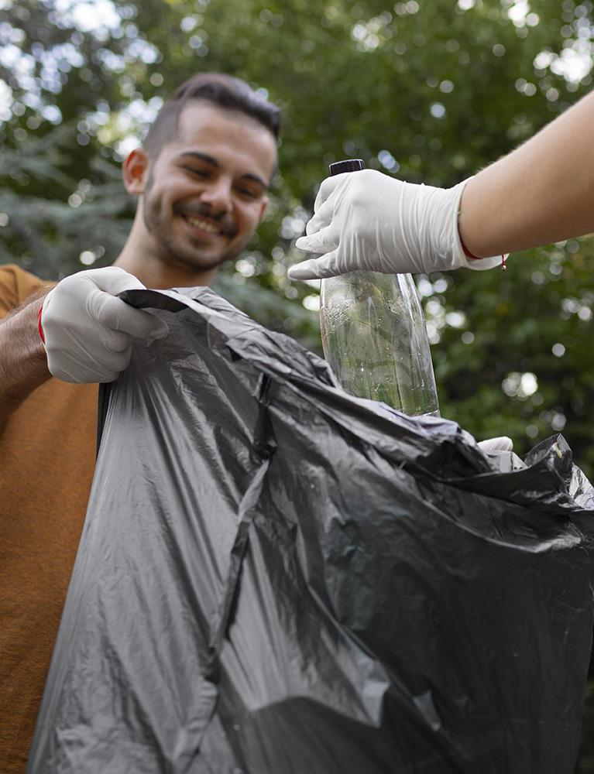
TABLET APP
You can replace the image on the screen with your own work. Right-click on it and then choose "Replace image" so you can
add yours

Slide 28
THANK YOU!
DO YOU HAVE ANY QUESTIONS?
youremail@freepik.com
+91 620 421 838
yourwebsite.com
Please keep this slide for attribution

Slide 29
RECYCLING ICON PACK

Slide 30
ALTERNATIVE RESOURCES

Slide 31
ALTERNATIVE RESOURCES

Slide 32
ALTERNATIVE INFOGRAPHICS
MARS
JUPITER
SATURN
VENUS
Despite being red, Mars is actually a very cold place to live on
It’s a gas giant and the biggest planet in the Solar System
Saturn is composed mostly of hydrogen and also helium
It has a beautiful name and is the second planet from the Sun

Slide 33
ALTERNATIVE INFOGRAPHICS
JUPITER
2,500
VENUS
It’s a gas giant and the biggest planet in the Solar System
Despite being red, Mars is actually a very cold place to live on
It has a beautiful name and is the second planet from the Sun

Slide 34
RESOURCES
Did you like the resources on this template? Get them for free at our other websites:
PHOTOS
Reusable plastic bottle with flowers
Close up woman planted flower in plastic bottle
VECTORS
Reuse gardening at the city
Flat recycling landing page template
Save the planet concept with people taking care of the earth
Organic flat design flowers collection

Slide 35
RESOURCES
Did you like the resources on this template? Get them for free at our other websites:
PHOTOS
Person doing selective recycle of garbage
People cleaning garbage from nature
Young smiley woman working in a greenhouse
Senior man harvesting fresh juicy oranges in the garden
Senior man cultivating oranges
Elder woman posing next to a plant in her garden
Female farmer working in a greenhouse
VECTORS
Leaves frame background with quote
People helping the planet and recycle
Ecology concept background flat style
People recycling with trash and bin
Flat style green leaves collection
Save the planet concept illustration with people and globe
ICON PACK
Recycling icon pack

